Slide 1

SharePoint Framework
February 10, 2017

Slide 2
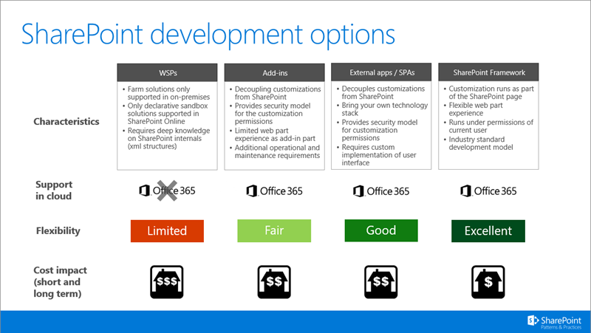
SharePoint Development Options

Slide 3
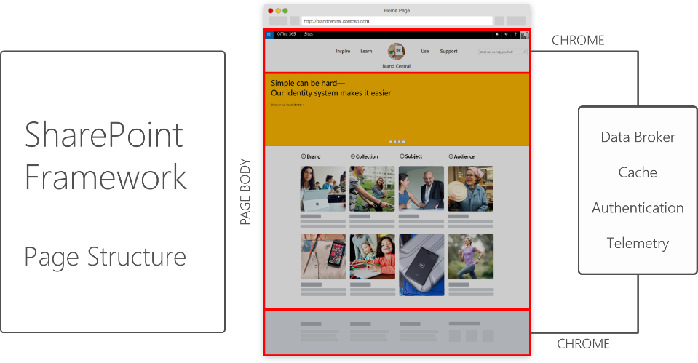
SharePoint Framework – New Page Structure Model
Notes:
One of the core components of the SharePoint Framework is the new, modern SharePoint Page experience, starting with the page structure.
In the new SharePoint user experience, pages can be technology independent and can be constructed using any client-side JavaScript and templating framework.
This page structure provides a number of new opportunities, in addition to the ability to host web parts, add-ins and more.

Slide 4
SharePoint Framework - Overview
The SharePoint Framework (SPFx) is a new application development model for Page(Modern Page) and Part(Client Side Web Parts) that enables full support for client-side development and open source tools. It also easily integrates with Microsoft graph.
The SharePoint Framework works for both SharePoint on-premises and SharePoint Online. It is still in developer preview(Currently on Release Candidate 0) and should be released to production in early 2017.
It’s used internally by the product team, and the same code is usable by 3rd party developers.
It runs in the context of the current user and connection in the browser. No iFrames.
The controls are responsive and accessible by nature.
It is framework agnostic – You can use any browser framework that you like – React, Handlebars, knockout, angular etc
New tool chain introduced and is based on common open source client development tools like NPM, TypeScript, yeoman, WebPack, gulp, etc.
Performance is key advantage for adopting SharePoint Framework
SPFx client-side solutions are approved by the tenant administrators (or their delegates)and it can be used by end users on all sites – even self service created sites like teams, groups, personal, etc.
Can be deployed in both classic web part and publishing pages as well as the modern pages.

Slide 5
Scenarios
Building custom Web Parts
Building vertical focused applications
Integrating with external systems
Enhancing the out of the box experience
Branding custom portals
Building custom Intranet Portals

Slide 6


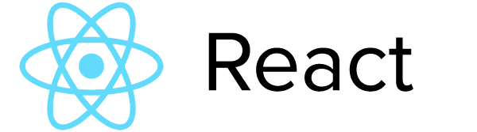
New Toolchain with Open source tooling support
All of the tools and technologies that internal Microsoft engineers use to build is available to third party developers
Node.js - cross-platform runtime environment for hosting and serving JavaScript
Node Package Manager (npm) - similar to NuGet, manages dependencies
Yeoman - scaffolding engine to kickstart new projects
Gulp - build process task runner
TypeScript - superset of JavaScript that compiles to plain JavaScript. SharePoint client-side development tools are built using TypeScript classes, modules, and interface
JavaScript Frameworks - The following are some of the most popular:
React
Angular
Handlebars

Slide 7



Server side tool comparison
IIS Express
C#
MSBuild
Project Templates

Slide 8
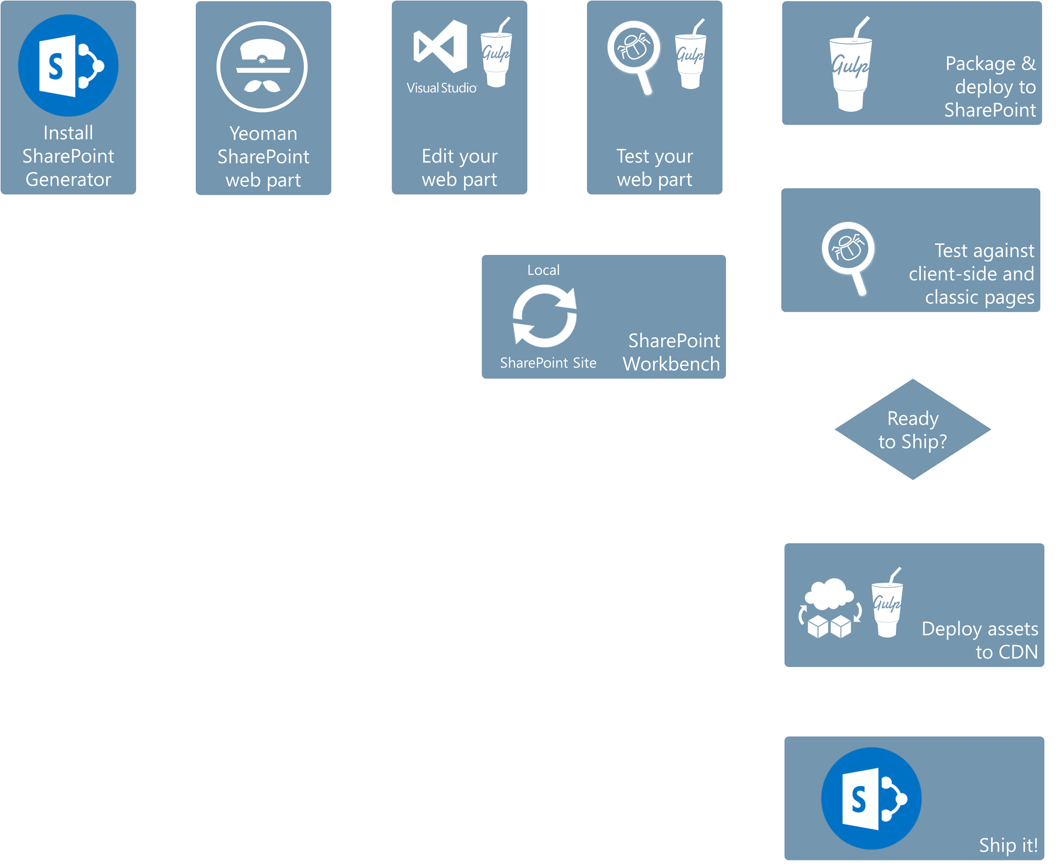

Slide 9
SharePoint Framework Development – Pre-Requisite
Office 365 Developer tenant
Node.js - cross-platform runtime environment for hosting and serving JavaScript
Node Package Manager (npm) - similar to NuGet, manages dependencies
Yeoman Generator for SPFX - “yo @microsoft/sharepoint”
Gulp - build process task runner
TypeScript - superset of JavaScript that compiles to plain JavaScript
Optional tools
Fiddler
Postman plugin for Chrome
GIT Source Control Tools
JavaScript Frameworks - The following are some of the most popular:
React
Angular
Handlebars

Slide 10
Steps to configure Development Environment
Enable First Release option in Office 365 Developer tenant
Install Node JS (Install LTS Version)
Enable Node Package Manager (npm) using the below command
npm install -g npm@3
Install Yeoman and Gulp using the below command
npm install -g yo gulp
Install Yeoman SharePoint generator using the below command
npm install -g @microsoft/generator-sharepoint
Install TypeScript using the below command
npm install –g typescript
npm install typings –global
npm install tsd -g
Install JavaScript Framework based on the selection of framework for Component Development
React - npm install --save react react-dom
Angular - npm install angular2
Handlebars - npm install handlebars

Slide 11
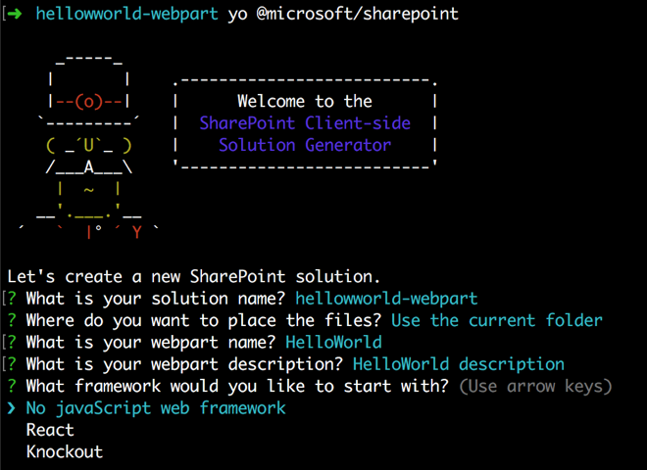
Steps to build SharePoint Framework Web Part
Create a Project Location locally (Example: md helloworld-webpart)
Go to the Project Directory (Example: cd helloworld-webpart
Create a new HelloWorld web part by running the Yeoman SharePoint Generator
yo @microsoft/sharepoint
Provide series of information requested about the web part as shown below
Yeoman will install the required dependencies and scaffold the solution files along with the HelloWorld web part. This might take a few minutes. When the scaffold is complete, you should see the following message indicating a successful scaffold
SharePoint client-side solution is HTML/TypeScript based. You can use any code editor like VS Code that supports client-side development to build your web part
Run npm i to install all the modules and dependencies mentioned in Package.JSON and use Gulp Serve to test the Web Part

Slide 12
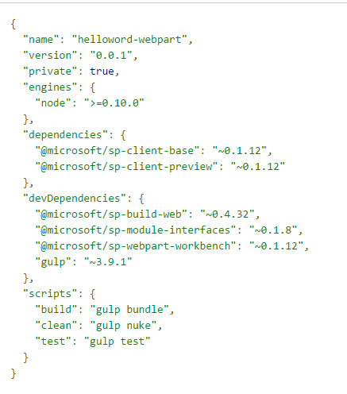
Scaffolding a SharePoint Framework Project
The SharePoint generator scaffolds a client-side project with a web part and also downloads and configures the required toolchain components for the specified client-side project.
The generator installs required npm packages locally in the project folder
The packages installed under the node_modules folder in the project folder. This folder contains the packages along with all of their dependencies.
The key SharePoint Framework packages are located under the node_modules\@microsoft folder.
Every time Developer create a new project using the generator, the generator installs the SharePoint Framework packages along with its dependencies for that specific project locally
The package.json file in the client-side project specifies the list of dependencies the project depends on. The list defines what dependencies to install. Below is the Package.JSON for Hello world Web Part Project
npm i command will scan the package.json file and install the required dependencies
Note: If you are using git as your source control system, the Yeoman scaffolded web part project includes a .gitignorefile that excludes the node_modules folder among other things. When Developer check out, or clone, the web part project from the source control system the first time, run the npm i command to initialize and install all the project dependencies locally:

Slide 13
SharePoint Framework Packages
SharePoint Framework consists of npm packages that work together to help developers build client-side experiences in SharePoint.Bundle and minify JavaScript and CSS files.
@microsoft/generator-sharepoint - A Yeoman plug-in for use with the SharePoint Framework. Using this generator, developers can quickly set up a new client-side web part project with sensible defaults and best practices.
@microsoft/sp-client-base - Defines the core libraries for client-side applications built using the SharePoint Framework Compile TypeScript files to JavaScript.
@microsoft/sp-webpart-base(@microsoft/sp-client-preview )- Contains SharePoint Framework libraries that are still under development. Once they are finalized, they will be refactored into separate npm packages.
@microsoft/sp-webpart-workbench - The SharePoint Workbench is a standalone environment for testing and debugging client-side web parts.
@microsoft/sp-module-loader - A module loader that manages versioning and loading of client-side components, web parts, and other assets. It also provides basic diagnostic services. It is built on familiar standards such as SystemJS and WebPack, and is the first part of the SharePoint Framework to load on a page.
@microsoft/sp-module-interfaces - Defines several module interfaces that are shared by the SharePoint Framework module loader and also the build system.
@microsoft/sp-lodash-subset - Provides a custom bundle of lodash for use with the SharePoint Framework's module loader. To improve runtime performance, it only includes a subset of the most essential lodash functions.
@microsoft/sp-tslint-rules - Defines custom tslint rules for usage with SharePoint client-side projects.
@microsoft/office-ui-fabric-react-bundle - Provides a custom bundle of office-ui-fabric-react that is optimized for use with the SharePoint Framework's module loader

Slide 14
Common Build Packages for SharePoint Framework
The following list of common build tools packages are in the SharePoint Framework:
@microsoft/sp-build-core-tasks - A collection of tasks for the SharePoint Framework build system, which is based on gulp. The sp-build-core-tasks package implements operations specific to SharePoint such as packaging solutions and writing manifests.
@microsoft/sp-build-web - Imports and configures a set of build tasks that are appropriate for a build target that will run in a web browser (as opposed to a Node.js environment).This package is intended to be imported directly by a gulp file that uses the SharePoint Framework build system.
@microsoft/gulp-core-build - The core gulp build tasks for building TypeScript, HTML, less, and other build formats. This package depends on several other npm packages that contain the following tasks:
@microsoft/gulp-core-build-typescript
@microsoft/gulp-core-build-sass
@microsoft/gulp-core-build-webpack
@microsoft/gulp-core-build-serve
@microsoft/gulp-core-build-karma
@microsoft/gulp-core-build-mocha
@microsoft/loader-cased-file - A wrapper for webpack's file-loader that can be used to modify the casing of the resulting filename. This is useful in some scenarios, such as when using a content delivery network (CDN) that only allows lowercase filenames.
@microsoft/loader-load-themed-styles - A loader that wraps the loading of CSS in script equivalent to require('load-themed-styles').loadStyles( /* css text */ ). It is designed to be a replacement for style-loader.
@microsoft/loader-raw-script - A loader that loads a script file's contents directly in a webpack bundle using an eval(…).
@microsoft/loader-set-webpack-public-path -A loader that sets the webpack_public_path variable to a value specified in the arguments, optionally appended to the SystemJs baseURL property. loader

Slide 15
Gulp
SharePoint Framework uses gulp as its task runner to handle processes like the following:
Bundle and minify JavaScript and CSS files.
Run tools to call the bundling and minification tasks before each build.
Compile LESS or SASS files to CSS.
Compile TypeScript files to JavaScript.
The toolchain consists of the following gulp tasks defined in the @microsoft/sp-build-core-tasks package:
Build: Builds the client-side solution project.
Bundle: Bundles the client-side solution project entry point and all its dependencies into a single JavaScript file.
Serve: Serves the client-side solution project and assets from the local machine.
Nuke: Cleans the client-side solution project's build artifacts from the previous build and from the build target directories (lib and dist)
Test: Runs unit tests, if available, for the client-side solution project.
package-solution: Packages the client-side solution into a SharePoint package.
deploy-azure-storage: Deploys client-side solution project assets to Azure Storage.
When web part project is ready to ship or deploy in a production server, Developer will target SHIP. The SHIP target also ensures that the minified version of the web part bundle is built. To target SHIP mode, Developers append the task with --ship:
Gulp –ship (In SHIP mode, the build tasks copy all of the web part assets, including the web part bundle, into the temp\deploy folder)

Slide 16
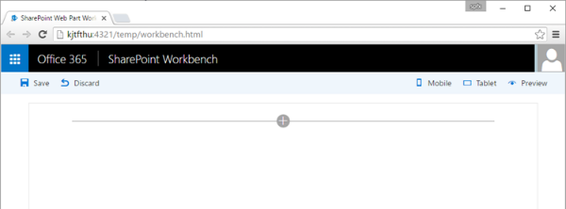
SharePoint Workbench
The SharePoint Workbench is a tool that allows you to build, debug and test your web parts on your development workstation. This means you don’t need to host SharePoint locally.
SharePoint Workbench includes the client-side page and the client-side canvas in which you can add, delete and test your web parts in development.
For Local SharePoint Workbench, The URL is https://localhost:4321/temp/workbench.html.
SharePoint workbench is also hosted in SharePoint. The full URL is https://your-sharepoint-site-url/_layouts/workbench.aspx
Note: If Developers do not have the SharePoint Framework developer certificate installed, then Workbench will notify that it is configured not to load scripts from localhost. Execute gulp trust-dev-cert command in the project directory console to install the developer certificate

Slide 17
SharePoint Framework - Deployment
Artifacts are deployed to a CDN, SharePoint list, or Azure web site
Deployment process involves two steps;
When you package your client-side solution, an .spapp package is created. This package looks very similar to any other SharePoint Add-in. This package contains the following major things:
An AppManifest - a regular SharePoint add-in AppManifest with the difference that the App element has a IsClientSideSolution="true" attribute
One or more features - a normal Feature element file
Deploy the Package to the App Catalog in your SharePoint tenant.

Slide 18
References
Latest Release Notes on SharePoint Framework Updates
SharePoint Framework API Reference
When to use SharePoint Framework
Quick Start
TypeScript
React
Angular 2
Handlebars
Code Samples
SharePoint Framework Code Samples
Code samples and developer content targeted towards SharePoint Framework client-side web parts.
Client Side Web Parts – Developer’s Guidance References
40 Fantastic Web Parts with SharePoint Framework
Advanced Topics
Information about updated SharePoint Framework Package & Common Build Packages
Integrate Build Tasks in SharePoint Framework Toolchain
Extending WebPack in SharePoint Framework Toolchain
Web Casts
Building Simple SharePoint Framework Web Part
Converting existing JS Apps to SharePoint Framework
SharePoint Framework Video Tutorials
SharePoint Customization – When to use which Model?

